Slide 1


Python File Shuffler
Yesho Pawan Reddy Reddipalli

Slide 2



Tool used to run the program
Visual Studio Code
Notes:
code editor

Slide 3

Programming language used
Python 3.11

Slide 4

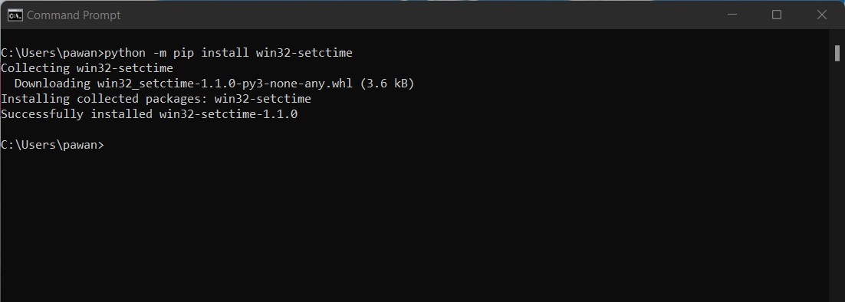
Prerequisites
Notes:
A small Python utility to set file creation time

Slide 5
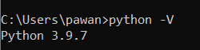
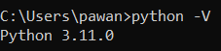
Updated python to the latest version

Slide 6
Modules used
os : Miscellaneous operating system interfaces
Time : Time access and conversions
Random : To generate pseudo-random numbers
win32-setctime : A Python utility to set file creation time

Slide 7
To display the files data
def display(path):
x,c=filesindir(path)
for i in x:
print("File Name: "+i)
print("Creation time: "+time.ctime(os.stat(path+'/'+i).st_ctime))
print("Modified time: "+time.ctime(os.stat(path+'/'+i).st_mtime))
print("Access time: "+time.ctime(os.stat(path+'/'+i).st_atime))

Slide 8
To count the files and add the name of the files to a list
def filesindir(path):
count=0 # to count the number of files in directory
files=[]
for x in os.listdir(path): # Iterate directory
# check if current path is a file
if os.path.isfile(os.path.join(path, x)):
# appends the files to the files list
files.append(x)
# if path is a file then increase the count
count+=1
return files,count

Slide 9
To rename the files
def rename(dir):
temp_files,count=filesindir(dir) # To change to name of the files temporarily
temp = 10000000
for src in temp_files:
ext=os.path.splitext(src)[1]
temp+=1
os.rename(dir+'/'+src,dir+'/'+str(temp)+ext)
files,count=filesindir(dir)
newname = []
for i in range(1,count+1):
newname.append(str(i))
random.shuffle(newname) #creating new shuffled numbers for naming the files
for src, dest in zip(files, newname):
ext=os.path.splitext(src)[1] # To find the extention of the files
os.rename(dir+'/'+src,dir+'/'+dest+ext) # renaming the files

Slide 10
To modify the timestamp of the files
def timemod(dir):
# Removing 10 days from the current time
# 10 days = 864000 seconds
time_stamp=time.time()-864000
x,c=filesindir(dir)
for i in x:
setctime(dir+'/'+i, time_stamp) # To set the file creation time
os.utime(dir+'/'+i, (time_stamp, time_stamp))
# To set the file modification time and access time

Slide 11
To automate the code according to the user input
print("Press 1 for the code to run every 30 seconds")
print("press 2 for the code to run every 1 week")
rep=int(input())
match rep:
case 1:
while(True): # For the code to run indefinitely
run_automation()
time.sleep(30) # sleeps for 30 seconds
print("30 seconds are done")
print("Running the code again\n")
case 2:
while(True): # For the code to run indefinitely
run_automation()
time.sleep(604800) # sleeps for 1 week or 604800 seconds
case _:
print("invalid key press again")

Slide 12
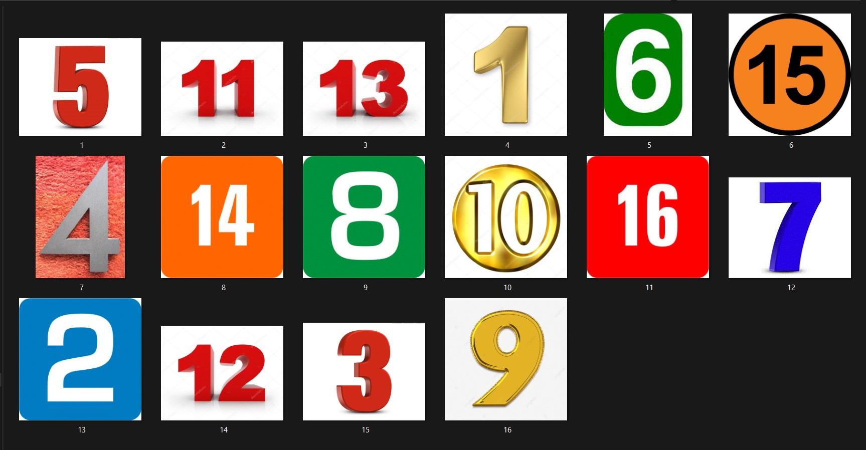
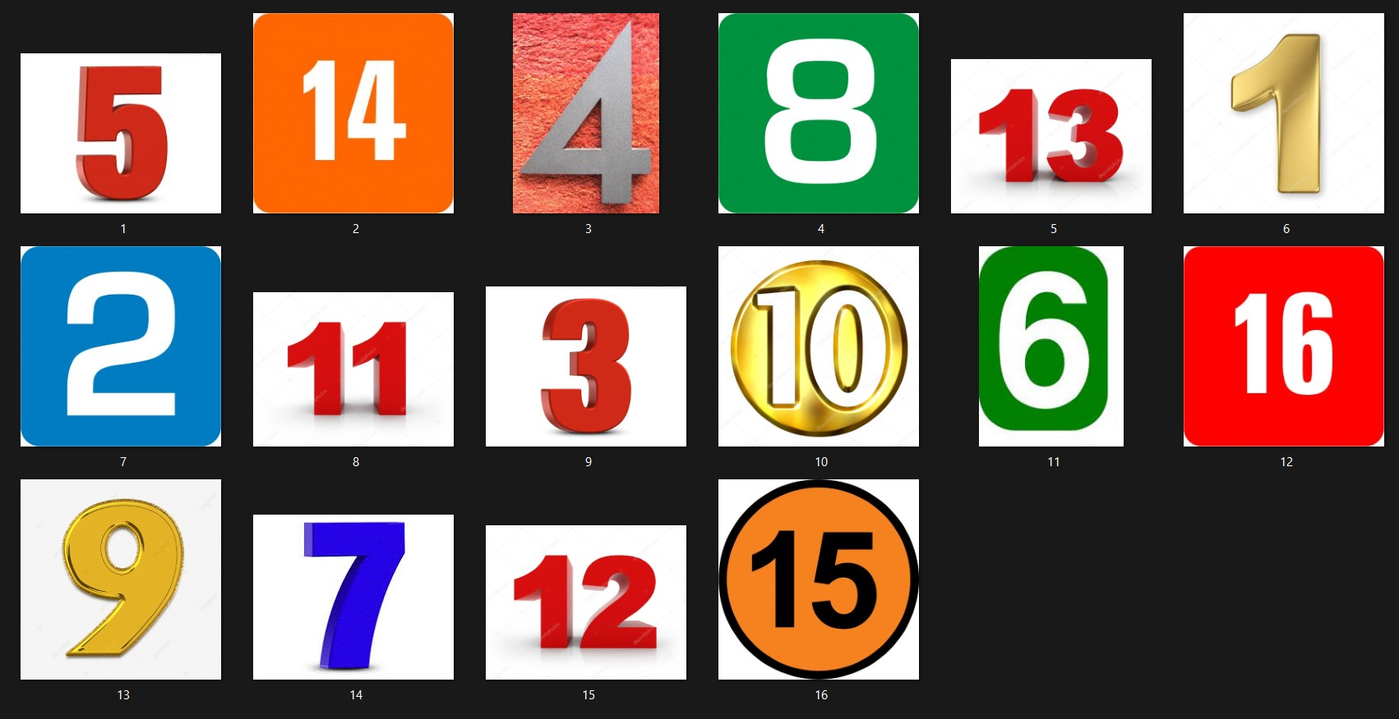
Result

Slide 13
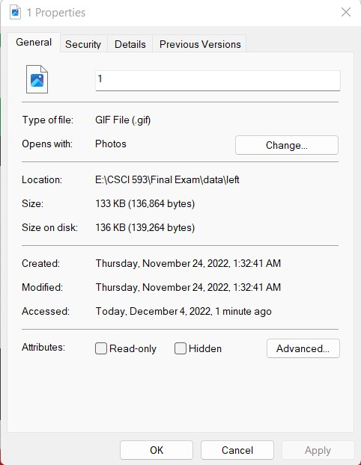
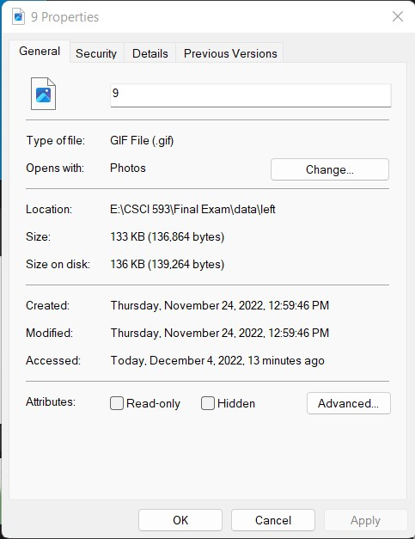
Results
Before
After

Slide 14
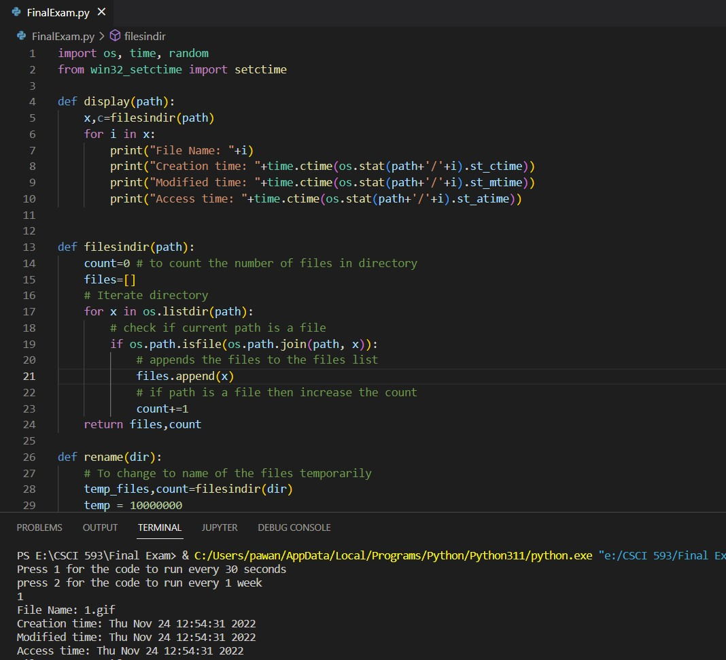
Code automation

Slide 15

Running the code

Slide 16
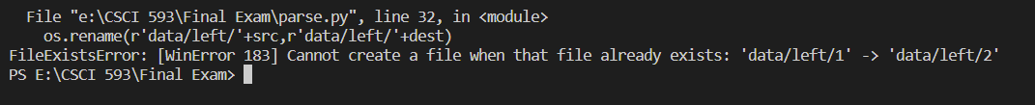
Problems faced
The program was unable to change the file names once they were renamed to a sequential order

Slide 17
Work Around
Had to temporarily rename the files then randomly rename the files with the count.
temp_files,count=filesindir(dir)
temp = 10000000
for src in temp_files:
ext=os.path.splitext(src)[1]
temp+=1
os.rename(dir+'/'+src,dir+'/'+str(temp)+ext)

Slide 18
Thank you

Slide 19
References
https://github.com/Delgan/win32-setctime/blob/master/README.md#win32-setctime
https://docs.python.org/3/library/os.html#os.rename

